Slide 1

RECOMMENDATION SYSTEM
ANALYSIS & MODELING
Compiled By: Selorm Etse-Forfoe

Slide 2
Goal
Personalize item suggestions for users based on their interaction history (clicks, add to cart, and transactions)
2

Slide 3
Objectives
Develop Personalized Recommendations
Implement systems for product, content, and service recommendations.
Leverage past user actions to make accurate predictions.
Improve user satisfaction and retention through relevant suggestions.
Ensure Scalability & Real-Time Performance
Increase sales and conversion rates through better user personalization.
Balance Accuracy & Diversity – Provide relevant but varied recommendations to avoid monotony
3

Slide 4
The CRISP-DM Framework
Develop business problem and analytical questions.
Understand data and preprocess data.
Develop visualizations to communicate insights to business questions.
Provide comprehensive conclusions with actionable solutions from the analysis conducted.
4

Slide 5
Business and Analytical Questions
What common item properties are most frequently associated with items users add to cart after viewing?
How does the time spent viewing an item influence the likelihood of it being added to the cart or purchased?
Are there users whose behavior patterns deviate significantly from typical user behavior?
Do abnormal users tend to interact with a specific subset of items or categories?
What is the conversion funnel from view → add to cart → transaction, and how does it vary across item categories or user types?
When do users engage most with the platform, and does this affect conversions?
What are the most effective features for distinguishing normal from abnormal users?
Can user viewing patterns be used to accurately predict the category of the item they are likely to add to cart?
5

Slide 6
Dataset Preparation
3 Datasets;
Item_Properties.csv – 16,638,802 x 4
Events.csv – 2,756,101 x 5
Category_Tree.csv - 1,669 x 2 columns
Removed hashed value rows
Merged all 3 datasets, pivoting “categoryid” and “available
Final Dataset Shape - 2,755,607 × 8
6

Slide 7
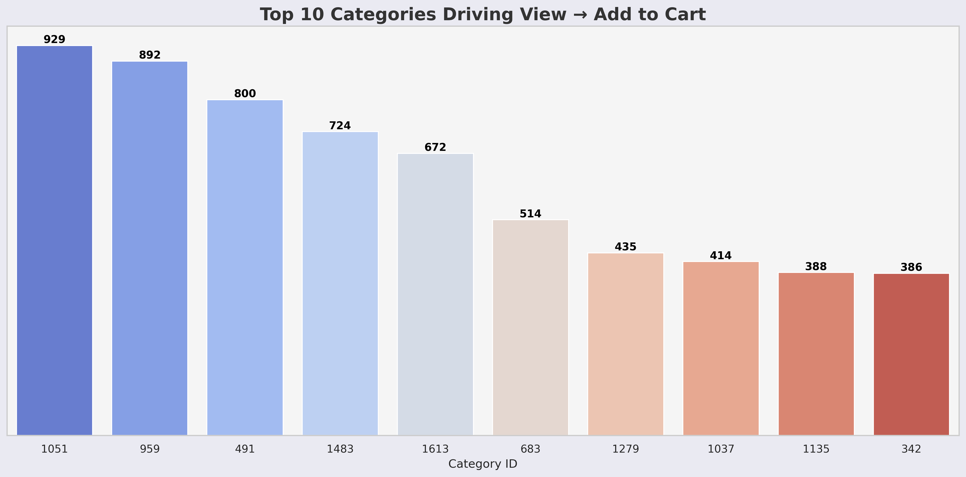
1. What common item properties are most frequently associated with items users add to cart after viewing?
Categories 1051, 959, and 491 dominate view-to-cart conversions, indicating strong product appeal.
Mid- and low-ranking categories present growth potential with targeted optimization.
7

Slide 8
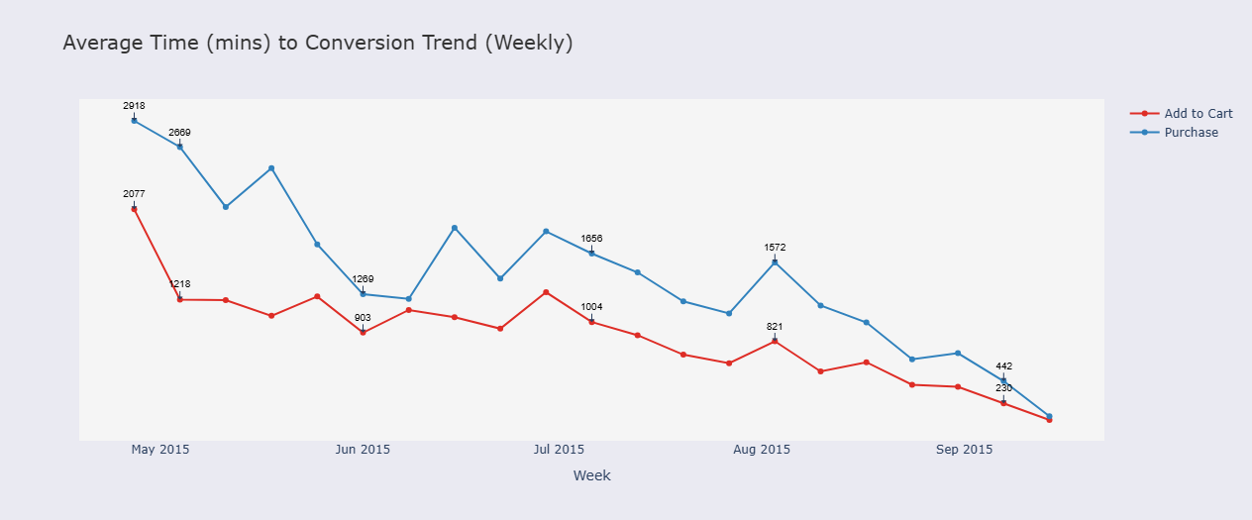
2. How does the time spent viewing an item influence the likelihood of it being added to the cart or purchased?
Conversion times have steadily decreased across the period, with purchase delays dropping by over 80%.
Faster add-to-cart and purchase actions indicate growing platform efficiency and user decisiveness.
8

Slide 9
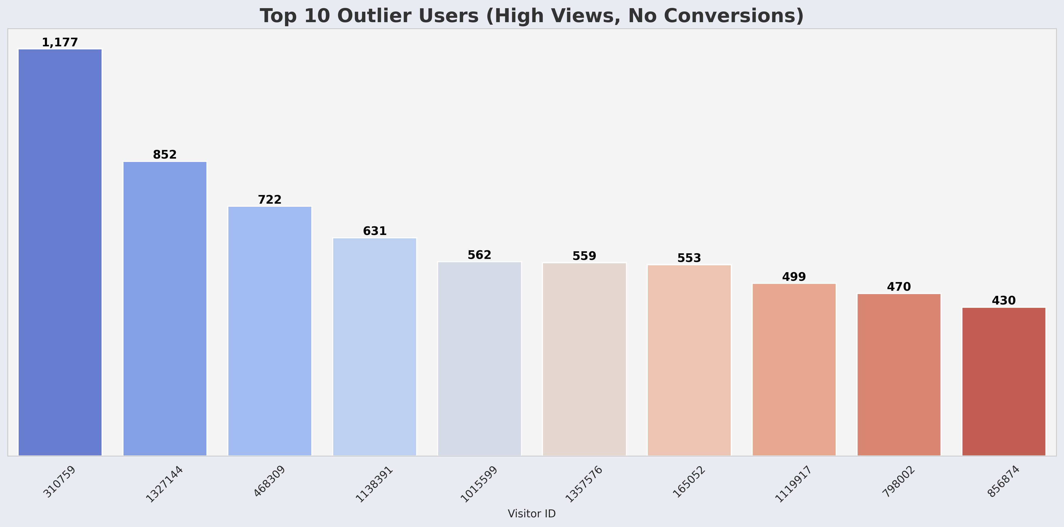
3. Are there users whose behavior patterns deviate significantly from typical user behavior?
A small group of visitors accounts for disproportionately high views without converting.
Indicates potential user disengagement or non-genuine activity that needs targeted action.
9

Slide 10
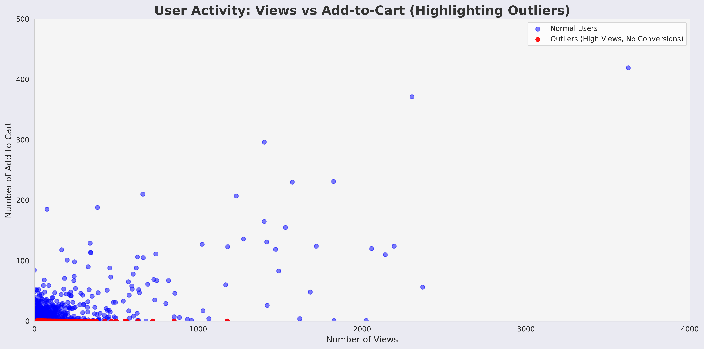
3. Are there users whose behavior patterns deviate significantly from typical user behavior?
Cont’d
Outlier detection reveals high-engagement but zero-conversion users.
Relevant for refining recommendation and fraud detection systems.
10

Slide 11
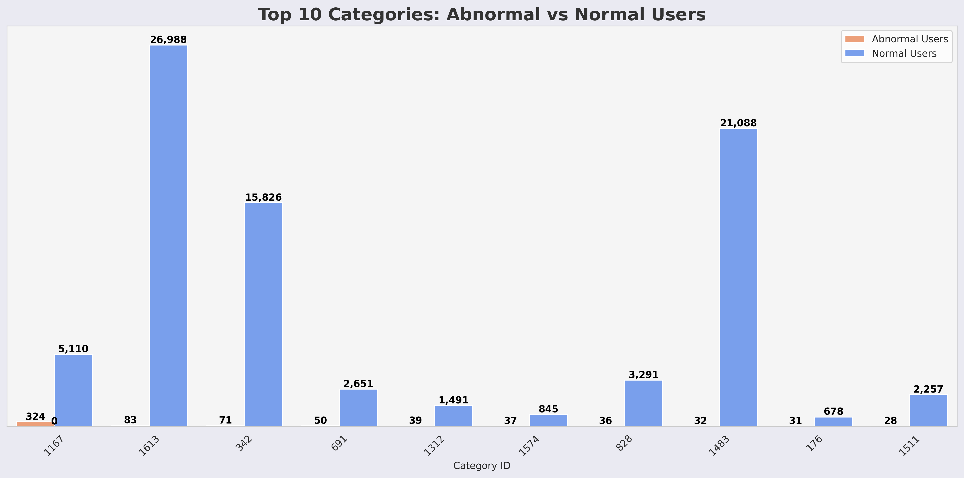
4. Do abnormal users tend to interact with a specific subset of items or categories?
Abnormal users’ category engagement is narrow and atypical, signaling potential automated or fraudulent activity.
11

Slide 12
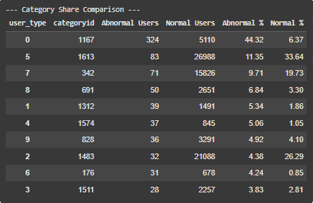
4. Do abnormal users tend to interact with a specific subset of items or categories?
Cont’d
Imbalance suggests that abnormal user activity is targeted toward niche categories, deviating from the broad and diverse exploration patterns of normal shoppers.
12

Slide 13
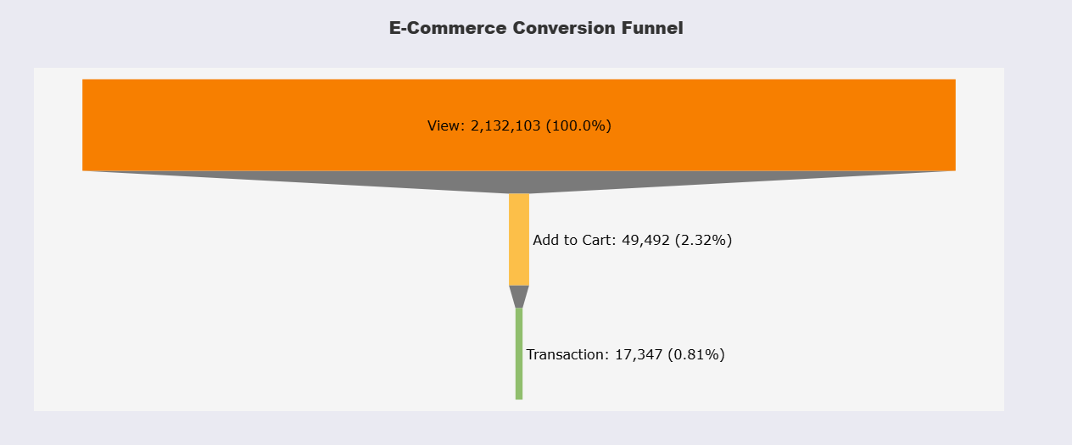
5. view → add to cart → transaction conversion, and how does it vary across item categories or user types?
High drop-off rates, especially between viewing and adding to cart.
Loss of over 97% of potential customers before they even add items to the cart.
13

Slide 14
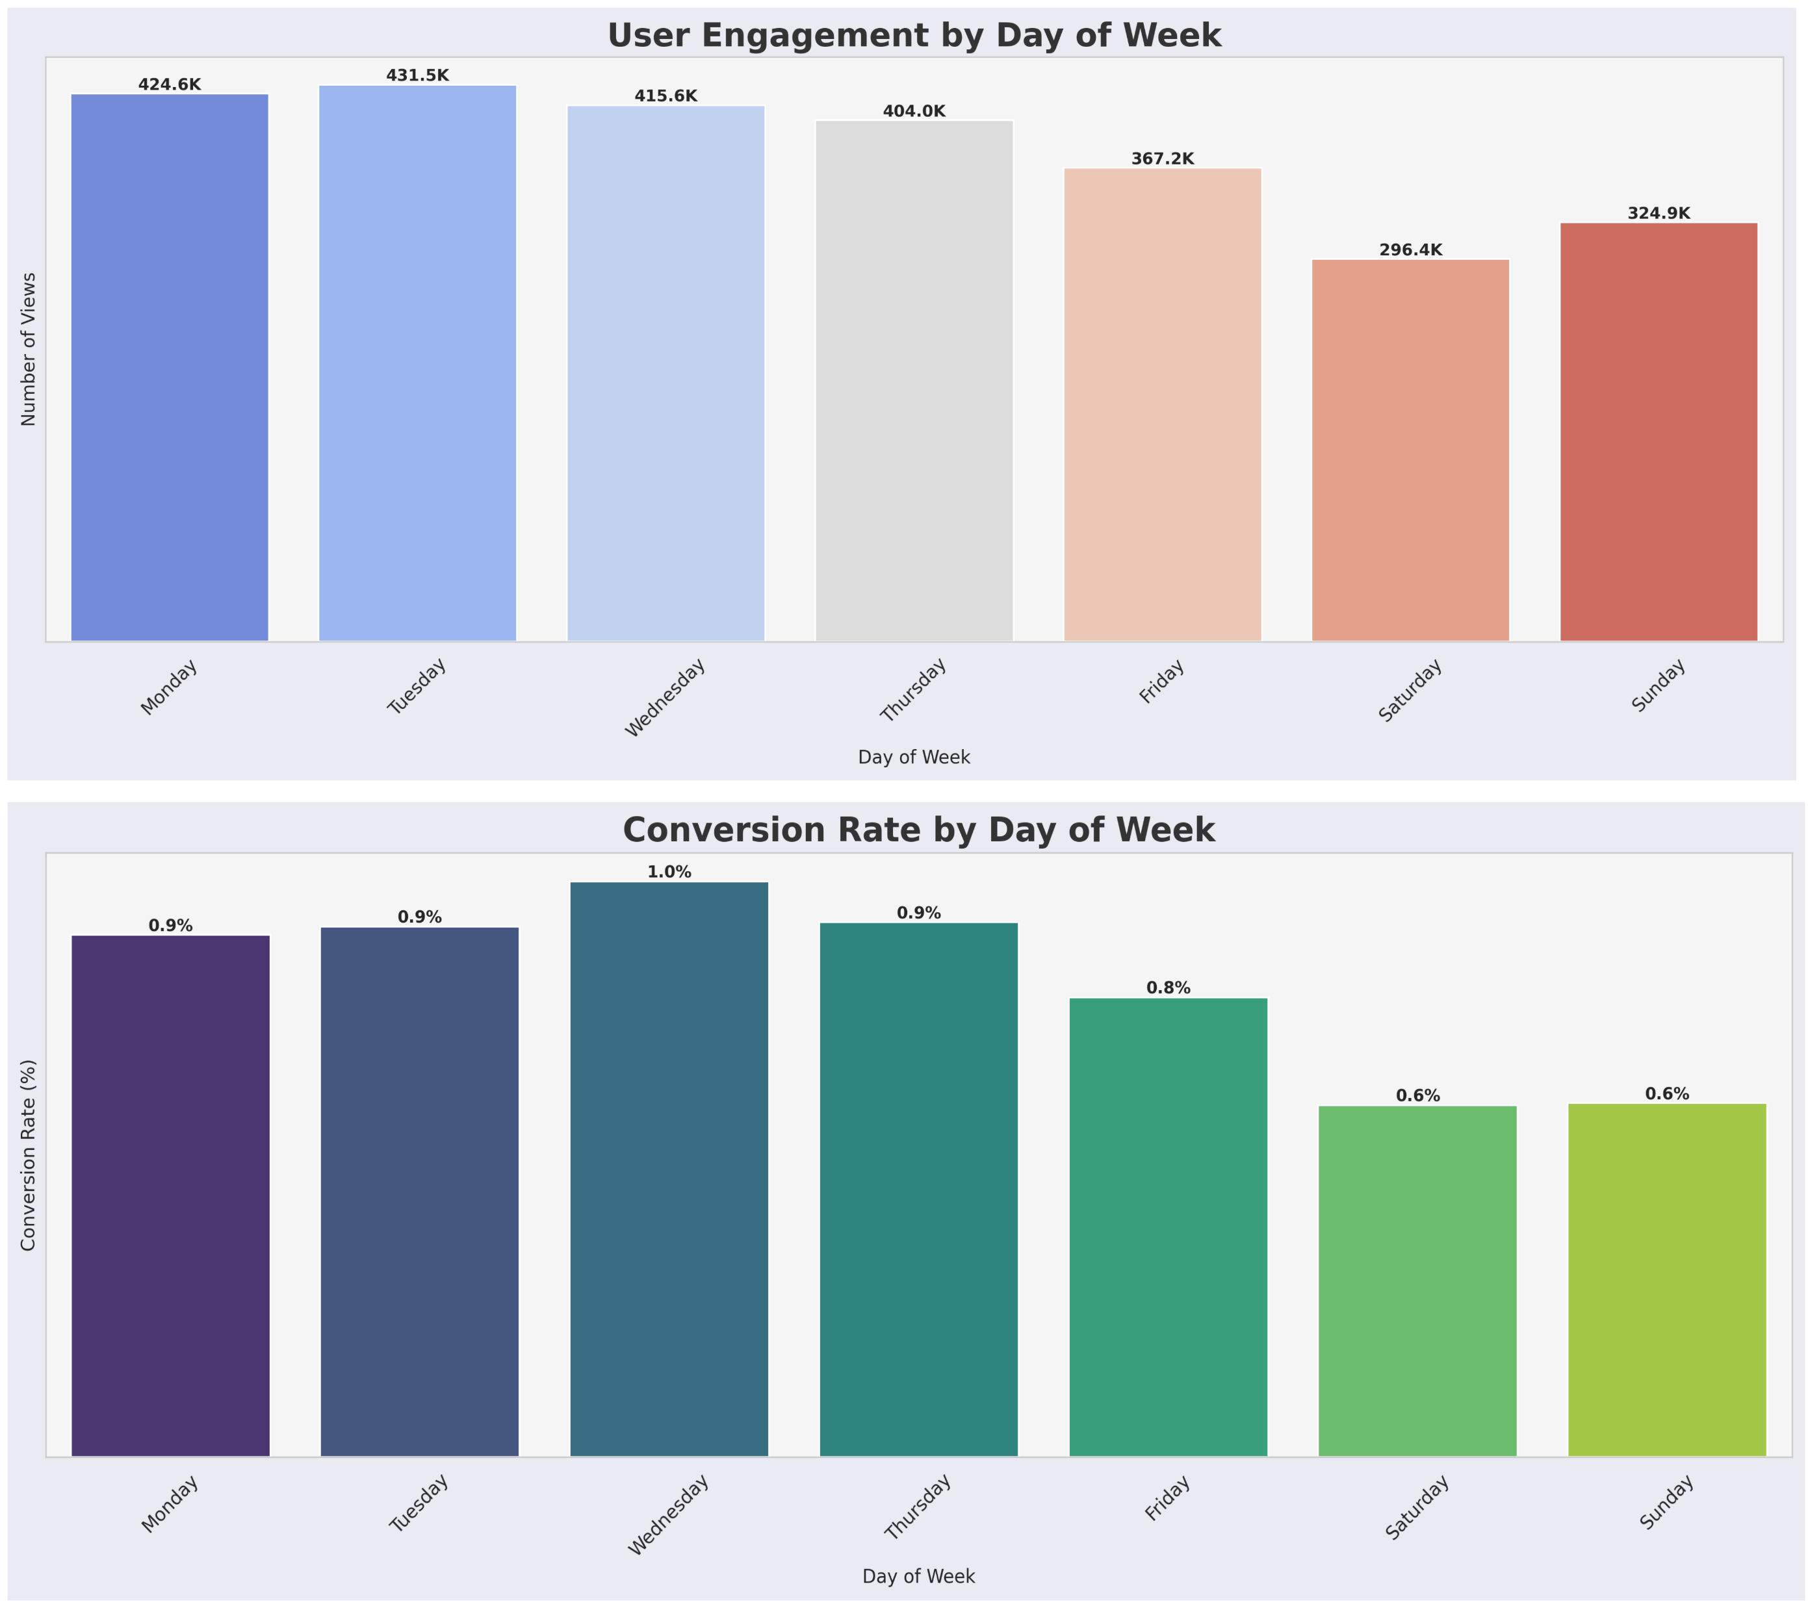
6. When do users engage most with the platform, and does this affect conversions?
Midweek (Wednesday–Thursday) – highest conversion rates despite Monday leading in views.
Weekend engagement is low, making midweek the optimal target for purchase-driven campaigns.
14

Slide 15
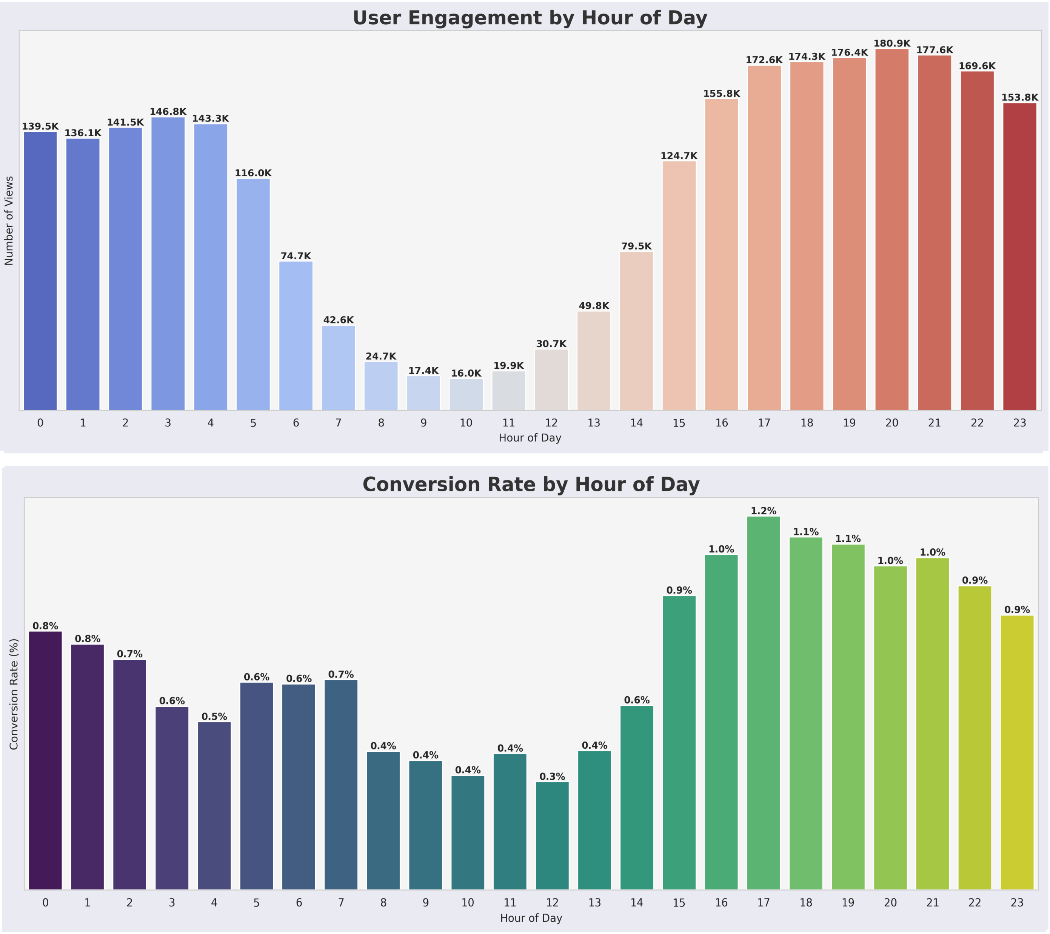
6. When do users engage most with the platform, and does this affect conversions?
Cont’d
Late evenings (19:00–23:00) are the platform’s prime windows for engagement and conversions.
Early mornings have minimal user activity.
15

Slide 16
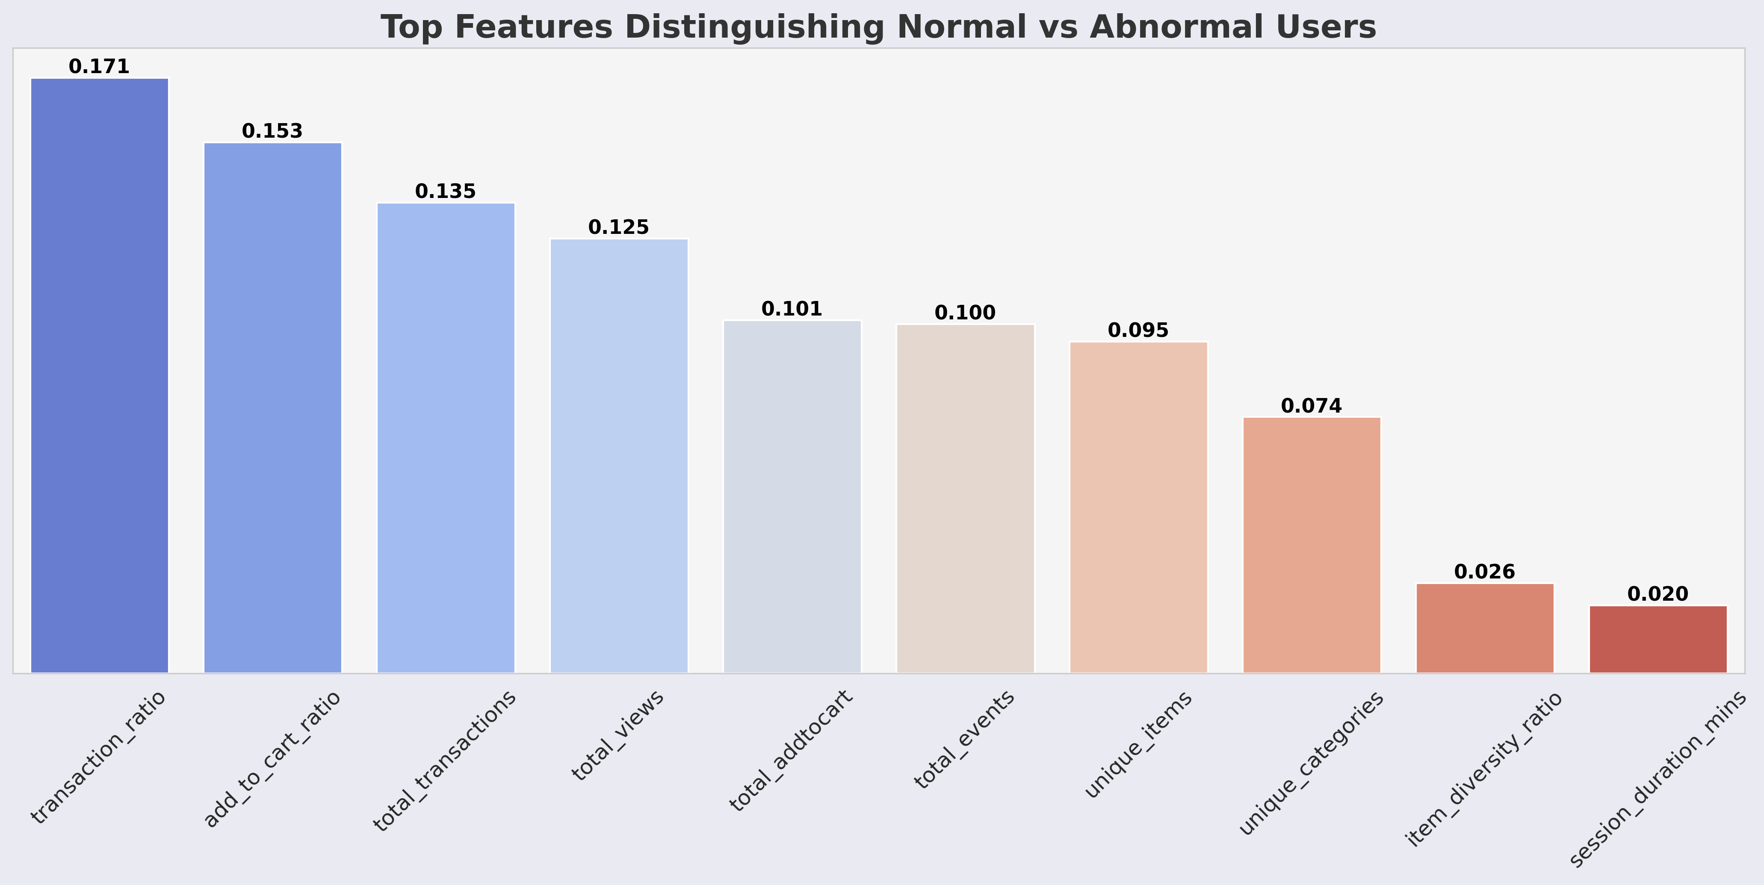
7. What are the most effective features for distinguishing normal from abnormal users?
Conversion-related features are the most effective in distinguishing abnormal from normal users.
Browsing metrics like session duration play a minor role.
16

Slide 17
8. Can user viewing patterns be used to accurately predict the category or price range of the item they are likely to add to cart?
Metric | Score | Interpretation
Top-1 Accuracy | 0.8499 | Correct category predicted first in ~85% of cases.
Top-3 Accuracy | 0.9214 | Correct category is in top 3 predictions in ~92% of cases.
Macro Precision | 0.5076 | When predicting a category, ~51% are correct across all classes.
Macro Recall | 0.3920 | Retrieves ~39% of actual categories correctly across all classes.
Macro F1-score | 0.4244 | Balanced precision and recall across classes at ~42%.
Random Forest Modeling
Viewing patterns can predict a user’s likely product category with 85% Top-1 and 92% Top-3 accuracy.
Strong enough for live recommendations
17

Slide 18
General Insights and Conclusions
Viewing patterns are strong predictors → 85% Top-1, 92% Top-3 accuracy.
Major funnel drop-offs: <3% of views → add-to-cart, <1% → purchase.
Peak engagement midweek evenings (Wed–Thu, 7–11 PM).
Abnormal users show extreme views with no conversions.
Some categories dominate conversions (1051, 959, 491).
18

Slide 19
Recommendations
Deploy the Top-3 category recommendation system.
Optimize conversion funnel → simplify checkout & address pricing barriers.
Targeted campaigns midweek evenings to boost engagement.
Detect & filter abnormal (bot-like) user activity.
Enrich datasets with metadata (category names, product attributes) for richer analysis & clearer insights.
19

Slide 20
Relevant Resources
Recommendation System App Link
https://huggingface.co/spaces/selorm-etse-forfoe/ecommerce-item-category-recommendation-system
GitHub Repository
https://github.com/dspselorm/Recommendation-System-Analysis
20

Slide 21
THANK YOU!
21

